Slide 1


Introduction to the Linked Data Platform (LDP) Hector Correa hjc14@psu.edu The Pennsylvania State University

Slide 2
Agenda
What is the Linked Data Platform
Basic definitions of concepts and rules
Examples
Why this is important
Q&A

Slide 3
Related Sessions
Linked data, URIs, and labels by Trey Terrel
Introducing Hydra-works: PCDM in Hydra by Lynette Rayle

Slide 4
Linked Data
First introduced by Tim Berners-Lee in 2006
The Semantic Web isn't just about putting data on the web. It is about making links, so that a person or machine can explore the web of data
Use URIs as names for things
Use HTTP URIs so that people can look up those names
Use standards for representation (RDF, SPARQL)
Include other URIs so that they can discover more things
See http://www.w3.org/DesignIssues/LinkedData.html

Slide 5
RDF 101
Resource Description Framework
Data expressed in triples
<subject> <predicate> <object>
For example
<hydraconnect> <location> “Minneapolis”
<hydraconnect> <date> “2015-09-22”

Slide 6
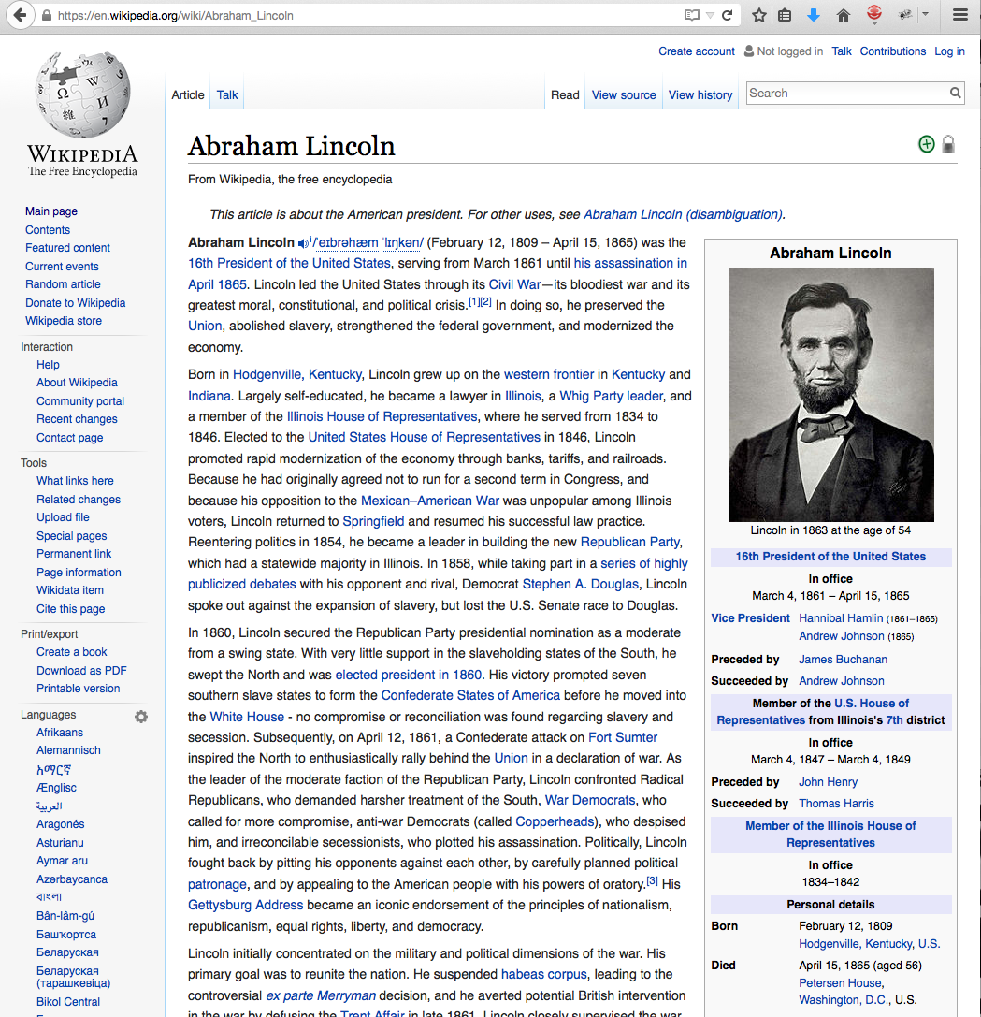
https://en.wikipedia.org/wiki/Abraham_Lincoln
Birth place

Slide 7
Linked Data Sample
curl http://dbpedia.org/data/Abraham_Lincoln.n3
@prefix dbr: <http://dbpedia.org/resource/>.
dbr:Abraham_Lincoln rdf:type yago:PresidentsOfTheUnitedStates .
dbr:Abraham_Lincoln dbp:birthPlace "Hodgenville, Kentucky” .
dbr:Abraham_Lincoln dbo:birthPlace dbr:Hodgenville,_Kentucky .
http://dbpedia.org/resource/Abraham_Lincoln
http://dbpedia.org/resource/Hodgenville,_Kentucky

Slide 8
From read-only to read-write
How are we supposed to update Linked Data
Intuitively we assume that we must use HTTP verbs and RDF…
…but what are the mechanics, restrictions, how to we deal with containership

Slide 9
Linked Data Platform (LDP)
“defines a set of rules for HTTP operations on web resources, some based on RDF, to provide an architecture for read-write Linked Data on the web” http://www.w3.org/TR/ldp/
W3C Recommendation as of Feb/2015

Slide 10
LDP is an HTTP API for read-write Linked Data

Slide 11
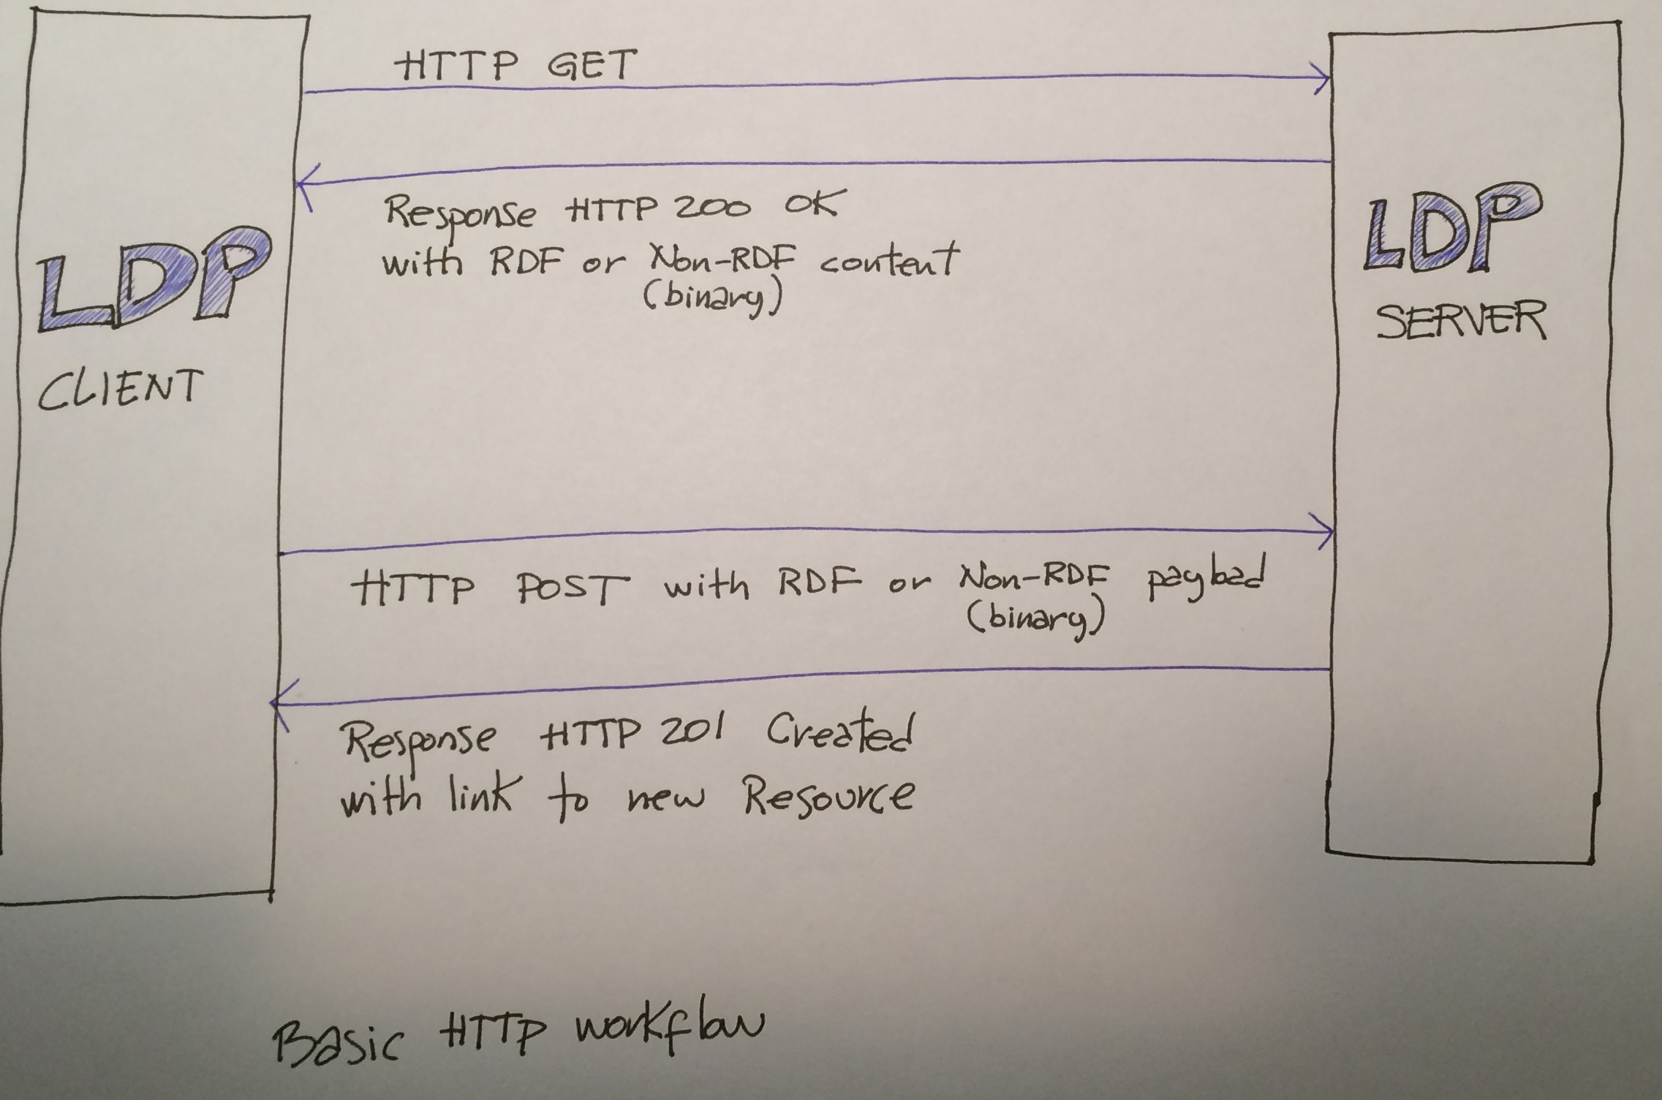
Basic HTTP workflow

Slide 12
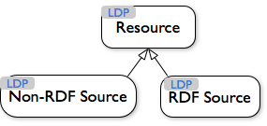
Concepts
Everything is a Resource
RDF Sources: expressed in RDF
Non-RDF Sources: everything else (Web pages, PDFs, image/audio/video files, binaries, et cetera)
http://www.w3.org/TR/ldp/

Slide 13
Create a New RDF Source
HTTP POST to create a
new RDF Source
(hydraconnect2015)
HTTP request
POST localhost/ HTTP/1.1
Slug: hydraconnect2015
<> dcterms:title “Hydra Connect 2015”.
<> dcterms:subject “Hydra conference in Minneapolis”.
HTTP response
HTTP/1.1 201 Created
Location: http://localhost/hydraconnect2015/
Triples for the new resource
Yup, created
…and here is the URL of the new resource

Slide 14
Fetch an Existing RDF Source
HTTP GET request
Client makes HTTP request
GET localhost/hydraconnect2015 HTTP/1.1
Server returns HTTP response
HTTP/1.1 200 OK
Content-Type: text/turtle
Link: <http://www.w3.org/ns/ldp#BasicContainer>; rel="type”,
<http://www.w3.org/ns/ldp#Resource>; rel="type”
@prefix dcterms: <http://purl.org/dc/terms/>.
@prefix ldp: <http://www.w3.org/ns/ldp#>.
<localhost/hydraconnect2015/> a ldp:BasicContainer ;
dc:title “Hydra Connect 2015” ;
dc:subject ““Hydra conference in Minneapolis” .
An RDF source that is a container
RDF triples (in Turtle)

Slide 15
Create a New Non-RDF Source
HTTP POST to create
a new Non-RDF Source
HTTP request
POST localhost/ HTTP/1.1
Slug: logo.jpg
Content-Type: image/jpeg
Content- Length: 1020
[binary of the image goes here]
HTTP response
HTTP/1.1 201 Created
Location: http://localhost/logo.jpg
Binary data
…and here is the URL of the new resource

Slide 16
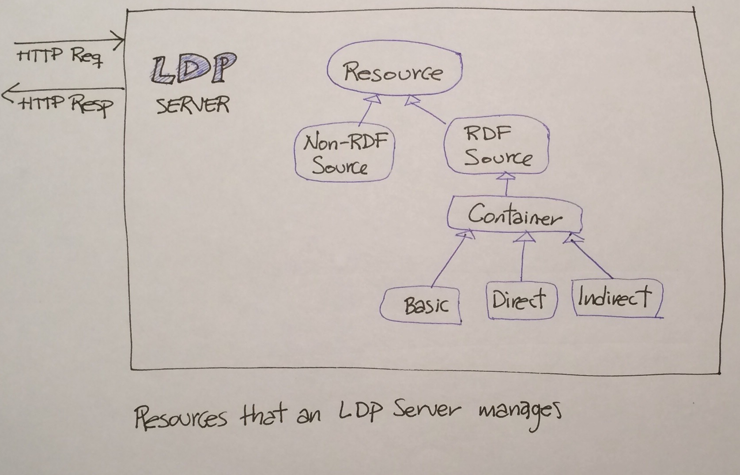

Concepts (expanded)
http://www.w3.org/TR/ldp/

Slide 17
Adding an RDF Source to a Basic Container (1/2)
HTTP POST request
HTTP request
POST localhost/hydraconnect2015/ HTTP/1.1
Slug: session1
<> dcterms:title “Welcome to Hydra Connect 2015”.
<> dcterms:subject “blah blah”.
HTTP response
HTTP/1.1 201 Created
Location: http://localhost/hydraconnect2015/session1

Slide 18
Adding an RDF Source to a Basic Container (2/2)
Fetch the container
HTTP request
GET localhost/hydraconnect2015/ HTTP/1.1
HTTP response
HTTP/1.1 200 OK
Content-Type: text/turtle
Link: <http://www.w3.org/ns/ldp#BasicContainer>; rel="type”,
<http://www.w3.org/ns/ldp#Resource>; rel="type”
@prefix dcterms: <http://purl.org/dc/terms/>.
@prefix ldp: <http://www.w3.org/ns/ldp#>.
<localhost/hydraconnect2015/> a ldp:BasicContainer ;
dc:title “Hydra Connect 2015” ;
dc:subject ““Hydra conference in Minneapolis” ;
ldp:contains <localhost/hydraconnect2015/session1> .
New triple added by the LDP Server

Slide 19
Defining a Direct Container
HTTP request
POST localhost/hydraconnect2015/ HTTP/1.1
Slug: speakers
<> dcterms:title “Speakers at Hydra Connect 2015”.
<> ldp:membershipResource <localhost/hydraconnect2015> .
<> ldp:isMemberOfRelation hasSpeaker .
HTTP response
HTTP/1.1 201 Created
Location: http://localhost/hydraconnect2015/speakers
Notice these LDP specific triples

Slide 20
Adding to a Direct Container
HTTP POST request
HTTP request
POST localhost/hydraconnect2015/speakers HTTP/1.1
Slug: janedev
<> dcterms:title “Jane Developer”.
HTTP response
HTTP/1.1 201 Created
Location: http://localhost/hydraconnect2015/speakers/janedev

Slide 21
…but there is more
Fetch the resource indicated in the ldp:hasMemberRelationship
of the Direct Container
HTTP request
GET localhost/hydraconnect2015
HTTP response
HTTP/1.1 200 OK
[bunch of HTTP headers go here]
<localhost/hydraconnect2015/> a ldp:BasicContainer ;
dc:title “Hydra Connect 2015” ;
dc:subject ““Hydra conference in Minneapolis” ;
ldp:contains <localhost/hydraconnect2015/session1> ;
hasSpeaker <localhost/hydraconnect2015/speakers/janedev> .
Triple with the predicate indicated in the Direct Container pointing to the new contained resource.

Slide 22
Containers
“Containers are at the heart of LDP” – Robert Sanderson
You can revert the relationship (Direct and Indirect Containers)
You can link to a totally different resource than the one added (Indirect Containers)
LDP Containers for the Perplexed
Read the W3C LDP Recommendation for more.

Slide 23
Updates
Updates have not been standardized :(
The Linked Data Platform Working Group is currently favoring LD Patch but still is deciding. [1]
Other candidates include SPARQL 1.1, SparqlPatch, TurtlePatch, and RDF Patch [1]
As of July/2015, Linked Data Patch Format (LD Patch) is a note, not a recommendation [1]
[1] LD Patch http://www.w3.org/TR/2015/NOTE-ldpatch-20150728/

Slide 24

Why is LDP important to Hydra?
Fedora 4 is an LDP Server
The Hydra Stack (i.e. your app) is an LDP Client
gems: LDP, ActiveTriples, ActiveFedora

Slide 25
Thanks!
Official W3C LDP Recommendation http://www.w3.org/TR/ldp/
LDP Primer http://www.w3.org/TR/ldp-primer/
Slides/notes/examples http://hectorcorrea.com/#/blog/introduction-to-ldp/67

